Slide 1
Advanced Computer Architecture (ACA 2019)
Dr. ZHANG Chun-yuan
College of Computer, NUDT
Fall, 2019

Slide 2
Lecture 06 Tomasulo's Algorithm
November 13, 2019

Slide 3
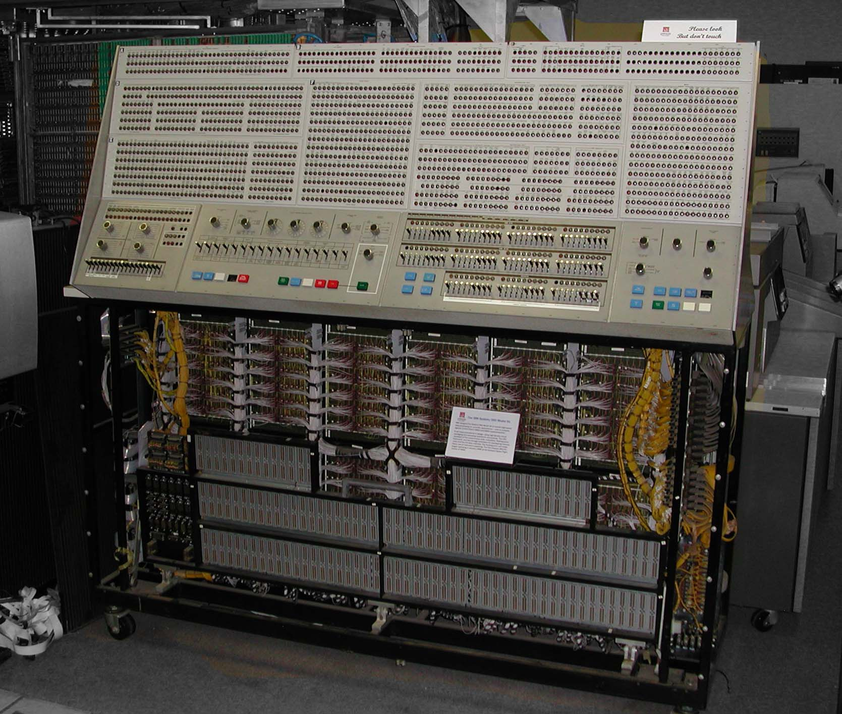
The Front Panel of System 360 Model 91 -- from Internet

Slide 4
Buffer
Functions
Queue
Virtual function units

Slide 5
Tomasulo Organization
From Mem
FP Op
Queue
FP Registers
Load Buffers
Load1
Load2
Load3
Load4
Load5
Load6
Store
Buffers
Add1
Add2
Add3
Mult1
Mult2
Reservation
Stations
To Mem
FP adders
FP multipliers
Common Data Bus (CDB)

Slide 6
Fields of Reservation Stations
Op: The operation to perform
Vj, Vk: value of the source operands
Qj, Qk: RSs producing source registers
Qj, Qk = 0 => ready
Only one of V or Q is valid for each operand
Busy: indicates this reservation station and its accompanying FUs are occupied

Slide 7
Register File Has a Field
Qi: the reservation station that contains the operation whose result should be stored into this register
If the value of Qi is blank (0), no currently active instruction is computing a result for this register (where is the value?)

Slide 8
Load And Store Buffers
Each have a filed A
A: hold the effective address
The store buffer also has a V field
V: value of the operands

Slide 9
How It Works: Previous Example
1. fld f6,32(x2)
2. fld f2,44(x3)
3. fmul.d f0,f2,f4
4. fsub.d f8,f2,f6
5. fdiv.d f0,f0,f6
6. fadd.d f6,f8,f2

Slide 10
Latencies and Checking Points
Latencies
Load is 1 clock cycle
Add/sub is 2
Multiply is 10
Divide is 40

Slide 11
Tomasulo Example
Instruction stream
3 Load/Buffers
FU count
down
3 FP Adder R.S.
2 FP Mult R.S.
Clock cycle counter

Slide 12
Tomasulo Example Cycle 1

Slide 13
Tomasulo Example Cycle 2
Note: Can have multiple loads outstanding?

Slide 14
Tomasulo Example Cycle 3
Note: MULT issued, registers are removed (“renamed”) in RSs
Load1 exec completing; what is waiting for Load1?

Slide 15
Tomasulo Example Cycle 4
Load2 exec completing

Slide 16
Tomasulo Example Cycle 5
Timer starts down for Add1, Mult1
May F0 course a error?

Slide 17
Tomasulo Example Cycle 6
Issue ADDD here despite name dependency on F6?

Slide 18
Tomasulo Example Cycle 7
Add1 (SUBD) completing; what is waiting for it?

Slide 19
Tomasulo Example Cycle 8

Slide 20
Tomasulo Example Cycle 9

Slide 21
Tomasulo Example Cycle 10
Add2 (ADDD) completing; what is waiting for it?

Slide 22
Tomasulo Example Cycle 11
Write result of ADDD here?
All quick instructions complete in this cycle!

Slide 23
Tomasulo Example Cycle 12

Slide 24
Tomasulo Example Cycle 13

Slide 25
Tomasulo Example Cycle 14

Slide 26
Tomasulo Example Cycle 15
Mult1 (MULTD) completing.Who is waiting?

Slide 27
Tomasulo Example Cycle 16
Just waiting for Mult2 (DIVD) to complete

Slide 28
Tomasulo Example Cycle 16-54
Faster than light computation (skip a couple of cycles)

Slide 29
Tomasulo Example Cycle 55

Slide 30
Tomasulo Example Cycle 56
Mult2 (DIVD) is completing. Who is waiting?

Slide 31
Tomasulo Example Cycle 57
In-order issue, o-o-o exec and o-o-o completion.

Slide 32
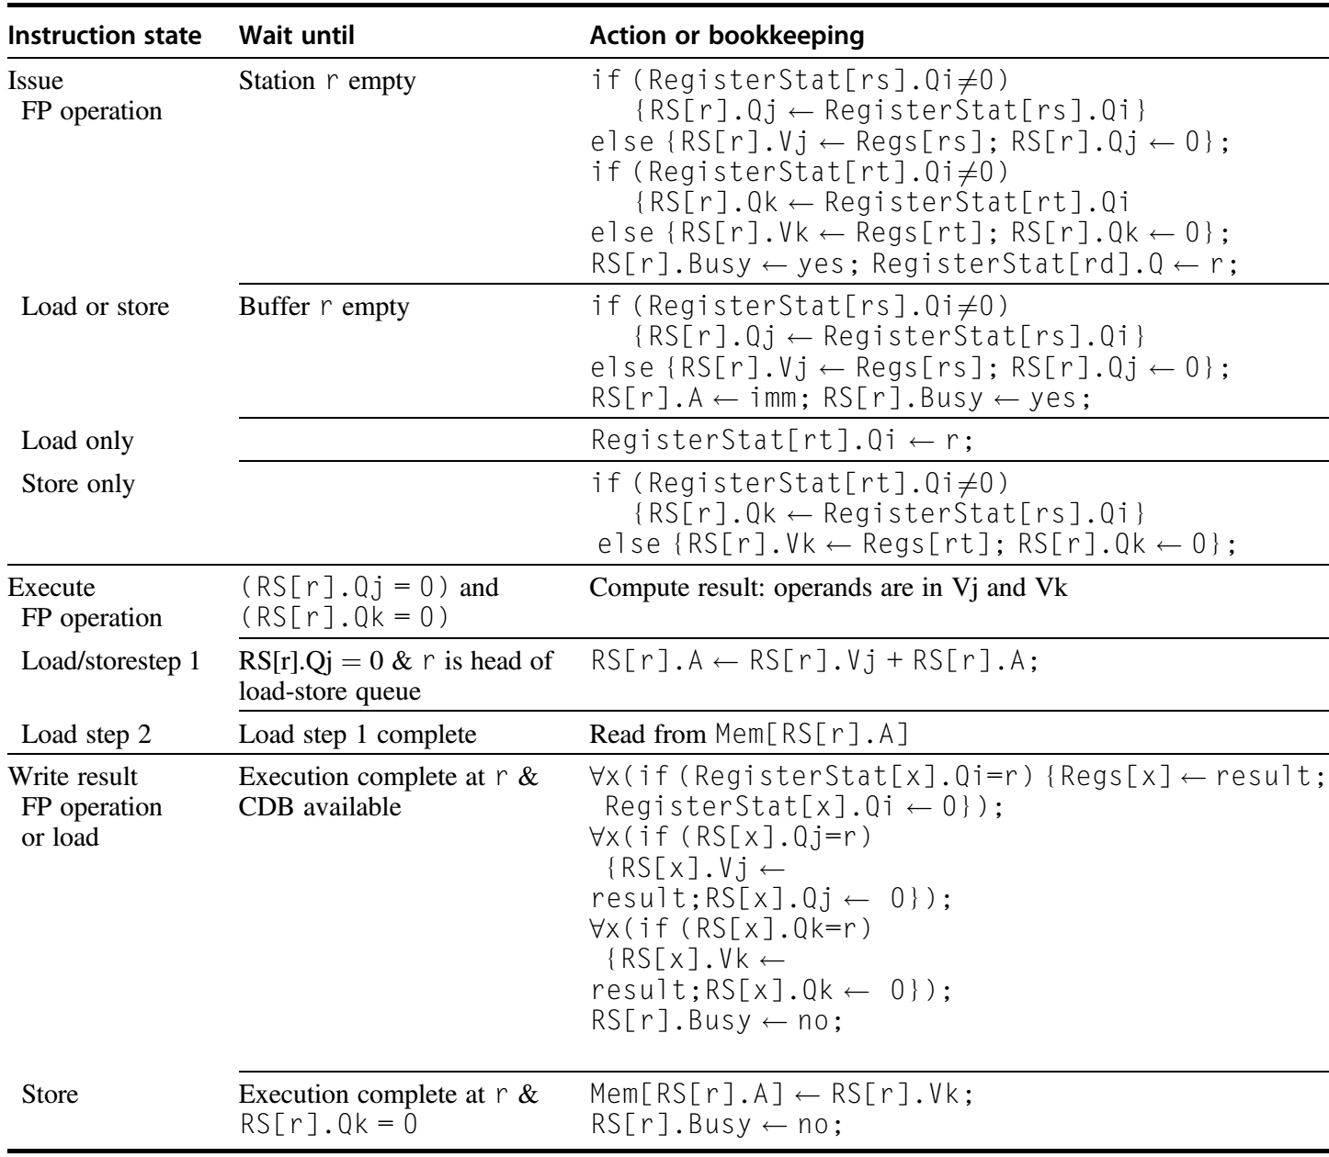
Steps in the Algorithm and What Is Required for Each Step p180, 5ed/p205, 6ed
Self learning

Slide 33
The Code
Loop: fld f0,0(x1)
fmul.d f4,f0,f2
fsd f4,0(x1)
addi x1,x1,-8
bne x1,x2,Loop
// branches if x16 != x2

Slide 34
Snapshot Time Assume
All branches are taken!
All of the instructions in two successive iterations of the loop have issued
But none has completed
The load and store buffers contain the addresses to be loaded from and stored to
The load values are in the load buffers
The store buffers indicate that the multiply destinations are the values to store

Slide 35
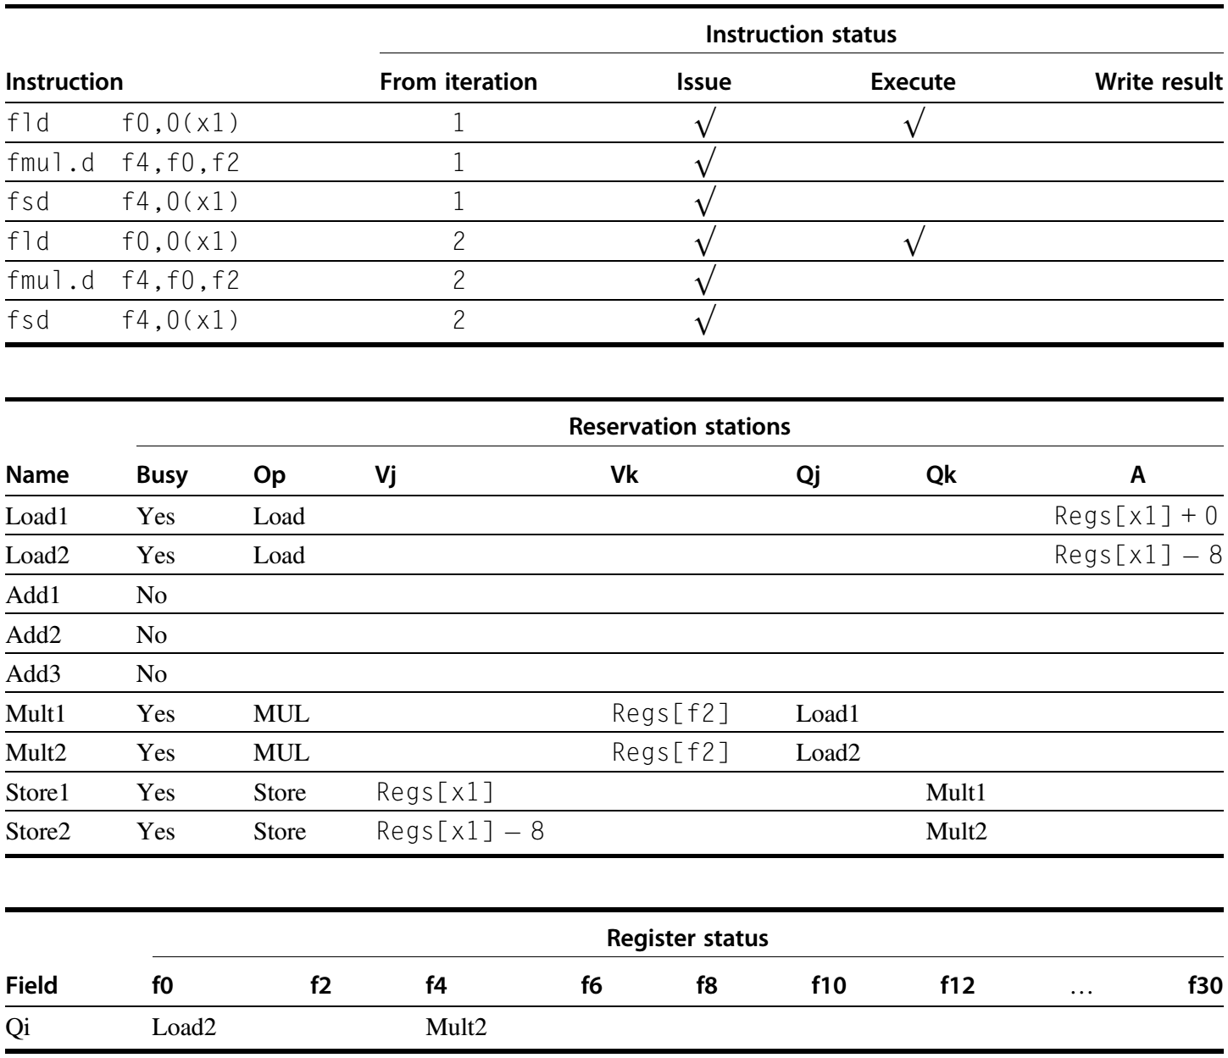
Two Active Iterations of The Loop with no Instruction Yet Completed
Self learning

Slide 36
Next …
Hardware-Based Speculation

Slide 37
HW Speculation and Prediction
HW speculation is subtle, but important, extension over branch prediction with dynamic scheduling
HW speculation
Fetch, issue, and execute instructions, as if predictions are always correct
Dynamic scheduling only fetches and issues such instructions

Slide 38
What about Precise Exceptions/Interrupts?
Recall: an exception is precise if there is a single instruction for which:
All instructions before that have committed (finished) their state
No following instructions (including the interrupting instruction) have modified any state
Both Scoreboard and Tomasulo have
In-order issue
out-of-order execution
out-of-order completion --> we need order

Slide 39
Done execute
Deposit result in ROB slot
Mark exception state
Instruction Fetch
Register File
Issue
FU
ROB
Write Back

Slide 40
On issue
Reserve slot at tail of ROB
Record dest reg, PC
Tag u-op with ROB slot
Instruction Fetch
Register File
Issue
FU
ROB
Write Back

Slide 41
WB head of ROB
Check exception, handle
Write register value, or
Commit the store
Instruction Fetch
Register File
Issue
FU
ROB
Write Back

Slide 42
Reorder Buffer + Forwarding
Forwarding committing results to later uncommitted operations
Instruction Fetch
Register File
Issue
FU
ROB
Write Back

Slide 43
Reorder Buffer + Forwarding + Speculation
Issue branch into ROB
Mark with prediction
Fetch and issue predicted instructions speculatively
Branch must resolve before leaving ROB
Resolve correct
Commit following instr
Resolve incorrect
Mark following instr in ROB as invalid
Let them clear
Instruction Fetch
Register File
Issue
FU
ROB
Write Back

Slide 44
What is that like?
Tomasulo's!
The key ideas
Out-of-order execution
Force them to in order commit
Prevent any irrevocable action, such as an exception, until an instruction commits
Instruction Fetch
Register File
Issue
FU
ROB
Write Back

Slide 45
3 components of HW-based speculation
Dynamic branch PREDICTION to choose which instructions to execute
Dynamic SCHEDULING different combinations of basic blocks
Speculation allow EXECUTION of instructions before control dependences are resolved
Ability to UNDO incorrectly speculated

Slide 46
Reorder Buffer (ROB)
Commit path
Reorder
Buffer
FP
Op
Queue
FP Regs
Res Stations
Res Stations
FP Adder
FP Adder

Slide 47
Fields of ROB 1/2
1. Instruction type (op code): indicates instructions
A branch (and has no destination result)
A store (which has a memory address destination)
A register operation (ALU operation or load, which have register destinations)

Slide 48
Fields of ROB 2/2
2. Destination field: where the instruction result should be written
The register number (for loads and ALU operations)
The memory address (for stores)
3. Value: hold the value of the instruction result until the instruction commits
4. Ready: indicates that instruction has completed execution, and the value is ready

Slide 49
RV with ROB Using Tomasulo's
Reorder Buffer
Busy?
FP Op
Queue
ROB7
ROB6
ROB5
ROB4
ROB3
ROB2
ROB1
Newest
Oldest
Registers
To
Memory
Dest
Dest
from
Memory
Dest
Reservation
Stations
FP adders
FP multipliers

Slide 50
Speculation: Original
Reorder Buffer
Busy?
FP Op
Queue
ROB7
ROB6
ROB5
ROB4
ROB3
ROB2
ROB1
Newest
1. fld f6,32(x2)
2. fld f2,44(x3)
3. fmul.d f0,f2,f4
4. fsub.d f8,f2,f6
5. fdiv.d f0,f0,f6
6. fadd.d f6,f8,f2
Oldest
Registers
To
Memory
Dest
Dest
from
Memory
Dest
Reservation
Stations
FP adders
FP multipliers

Slide 51
Speculation: Clock 1
Reorder Buffer
Busy?
FP Op
Queue
ROB7
ROB6
ROB5
ROB4
ROB3
ROB2
ROB1
Newest
1. fld f6,32(x2)
2. fld f2,44(x3)
3. fmul.d f0,f2,f4
4. fsub.d f8,f2,f6
5. fdiv.d f0,f0,f6
6. fadd.d f6,f8,f2
Oldest
f6
fld f6,32(x2)
y
Registers
To
Memory
Dest
Dest
from
Memory
Dest
Reservation
Stations
1 32+x2
FP adders
FP multipliers

Slide 52
Speculation: Clock 2
Reorder Buffer
Busy?
FP Op
Queue
ROB7
ROB6
ROB5
ROB4
ROB3
ROB2
ROB1
Newest
1. fld f6,32(x2)
2. fld f2,44(x3)
3. fmul.d f0,f2,f4
4. fsub.d f8,f2,f6
5. fdiv.d f0,f0,f6
6. fadd.d f6,f8,f2
f2
fld f2,44(x3)
y
Oldest
f6
fld f6,32(x2)
y
Registers
To
Memory
Dest
Dest
from
Memory
Dest
Reservation
Stations
1 32+x2
2 44+x3
FP adders
FP multipliers

Slide 53
Speculation: Clock 3
Reorder Buffer
Busy?
FP Op
Queue
ROB7
ROB6
ROB5
ROB4
ROB3
ROB2
ROB1
Newest
1. fld f6,32(x2)
2. fld f2,44(x3)
3. fmul.d f0,f2,f4
4. fsub.d f8,f2,f6
5. fdiv.d f0,f0,f6
6. fadd.d f6,f8,f2
f0
fmul.d f0,f2,f4
y
f2
fld f2,44(x3)
y
Oldest
f6
M(32+x2)
fld f6,32(x2)
y
Registers
To
Memory
Dest
Dest
from
Memory
Write Result
3 fmul.d ROB2,f4
Dest
Reservation
Stations
1 32+x2
2 44+x3
FP adders
FP multipliers

Slide 54
Speculation: Clock 4-1
Reorder Buffer
Busy?
FP Op
Queue
ROB7
ROB6
ROB5
ROB4
ROB3
ROB2
ROB1
Newest
1. fld f6,32(x2)
2. fld f2,44(x3)
3. fmul.d f0,f2,f4
4. fsub.d f8,f2,f6
5. fdiv.d f0,f0,f6
6. fadd.d f6,f8,f2
f8
fsub.d f8,f2,f6
y
f0
fmul.d f0,f2,f4
y
f2
fld f2,44(x3)
y
Oldest
n
Registers
To
Memory
Committed
Dest
Dest
from
Memory
4 fsub.d ROB2,f6
Write Result
3 fmul.d ROB2,f4
Dest
Reservation
Stations
2 44+x3
FP adders
FP multipliers

Slide 55
Speculation: Clock 4-2
Reorder Buffer
Busy?
FP Op
Queue
ROB7
ROB6
ROB5
ROB4
ROB3
ROB2
ROB1
Newest
1. fld f6,32(x2)
2. fld f2,44(x3)
3. fmul.d f0,f2,f4
4. fsub.d f8,f2,f6
5. fdiv.d f0,f0,f6
6. fadd.d f6,f8,f2
f8
fsub.d f8,f2,f6
y
f0
fmul.d f0,f2,f4
y
f2
M(44+x3)
fld f2,44(x3)
y
Oldest
n
Registers
To
Memory
Start to run
Dest
Dest
from
Memory
4 fsub.d M(44+x3),f6 2
3 fmul.d M(44+x3),f4 10
Dest
Write Result
Reservation
Stations
2 44+x3
FP adders
FP multipliers

Slide 56
Speculation: Clock 5
Reorder Buffer
Busy?
FP Op
Queue
ROB7
ROB6
ROB5
ROB4
ROB3
ROB2
ROB1
Newest
f0
fdiv.d f0,f0,f6
y
1. fld f6,32(x2)
2. fld f2,44(x3)
3. fmul.d f0,f2,f4
4. fsub.d f8,f2,f6
5. fdiv.d f0,f0,f6
6. fadd.d f6,f8,f2
f8
fsub.d f8,f2,f6
y
f0
fmul.d f0,f2,f4
y
f2
M(44+x3)
fld f2,44(x3)
n
Oldest
Registers
To
Memory
Committed
Dest
Dest
from
Memory
4 fsub.d M(44+x3),f6 1
3 fmul.d M(44+x3),f4 9
5 fdiv.d ROB3,f6
Dest
Reservation
Stations
2 44+x3
FP adders
FP multipliers

Slide 57
Speculation: Clock 6
Reorder Buffer
Busy?
FP Op
Queue
ROB7
ROB6
ROB5
ROB4
ROB3
ROB2
ROB1
Newest
f6
fadd.d f6,f8,f2
y
f0
fdiv.d f0,f0,f6
y
1. fld f6,32(x2)
2. fld f2,44(x3)
3. fmul.d f0,f2,f4
4. fsub.d f8,f2,f6
5. fdiv.d f0,f0,f6
6. fadd.d f6,f8,f2
f8
fsub.d f8,f2,f6
y
f0
fmul.d f0,f2,f4
y
Oldest
Registers
To
Memory
Dest
Dest
from
Memory
4 fsub.d M(44+x3),f6 0
6 fadd.d ROB4,f2
3 fmul.d M(44+x3),f4 8
5 fdiv.d ROB3,f6
Dest
Reservation
Stations
FP adders
FP multipliers

Slide 58
Speculation: Clock 7-1
Reorder Buffer
Busy?
FP Op
Queue
ROB7
ROB6
ROB5
ROB4
ROB3
ROB2
ROB1
Newest
f6
fadd.d f6,f8,f2
y
f0
fdiv.d f0,f0,f6
y
f8
fsub.d f8,f2,f6
y
f0
fmul.d f0,f2,f4
y
Oldest
Registers
To
Memory
Write Result
Dest
Dest
from
Memory
4 fsub.d M(44+x3),f6 -
6 fadd.d ROB4,f2
3 fmul.d M(44+x3),f4 7
5 fdiv.d ROB3,f6
Dest
Reservation
Stations
FP adders
FP multipliers

Slide 59
Speculation: Clock 7-2
Reorder Buffer
Busy?
FP Op
Queue
ROB7
ROB6
ROB5
ROB4
ROB3
ROB2
ROB1
Newest
f6
fadd.d f6,f8,f2
y
f0
fdiv.d f0,f0,f6
y
f8
f2-f6
fsub.d f8,f2,f6
y
f0
fmul.d f0,f2,f4
y
Oldest
Registers
To
Memory
Write Result
Dest
Dest
from
Memory
4 fsub.d M(44+x3),f6 -
6 fadd.d f2-f6,f2 2
3 fmul.d M(44+x3),f4 7
5 fdiv.d ROB3,f6
Dest
Reservation
Stations
FP adders
FP multipliers

Slide 60
Speculation: Clock 8
Reorder Buffer
Busy?
FP Op
Queue
ROB7
ROB6
ROB5
ROB4
ROB3
ROB2
ROB1
Newest
f6
fadd.d f6,f8,f2
y
f0
fdiv.d f0,f0,f6
y
f8
f2-f6
fsub.d f8,f2,f6
y
f0
fmul.d f0,f2,f4
y
Oldest
Registers
To
Memory
Dest
Dest
from
Memory
6 fadd.d f2-f6,f2 1
3 fmul.d M(44+x3),f4 6
5 fdiv.d ROB3,f6
Dest
Reservation
Stations
FP adders
FP multipliers

Slide 61
Speculation: Clock 9
Reorder Buffer
Busy?
FP Op
Queue
ROB7
ROB6
ROB5
ROB4
ROB3
ROB2
ROB1
Newest
f6
fadd.d f6,f8,f2
y
f0
fdiv.d f0,f0,f6
y
f8
f2-f6
fsub.d f8,f2,f6
y
f0
fmul.d f0,f2,f4
y
Oldest
Registers
To
Memory
Dest
Dest
from
Memory
6 fadd.d f2-f6,f2 0
3 fmul.d M(44+x3),f4 5
5 fdiv.d ROB3,f6
Dest
Reservation
Stations
FP adders
FP multipliers

Slide 62
Speculation: Clock 10-1
Reorder Buffer
Busy?
FP Op
Queue
ROB7
ROB6
ROB5
ROB4
ROB3
ROB2
ROB1
Newest
f6
fadd.d f6,f8,f2
y
f0
fdiv.d f0,f0,f6
y
f8
f2-f6
fsub.d f8,f2,f6
y
f0
fmul.d f0,f2,f4
y
Oldest
Write Result
Registers
To
Memory
Dest
Dest
from
Memory
6 fadd.d f2-f6,f2 0
3 fmul.d M(44+x3),f4 4
5 fdiv.d ROB3,f6
Dest
Reservation
Stations
FP adders
FP multipliers

Slide 63
Speculation: Clock 10-2
Reorder Buffer
Busy?
FP Op
Queue
ROB7
ROB6
ROB5
ROB4
ROB3
ROB2
ROB1
Newest
f6
f8-f2
fadd.d f6,f8,f2
y
f0
fdiv.d f0,f0,f6
y
f8
f2-f6
fsub.d f8,f2,f6
y
f0
fmul.d f0,f2,f4
y
Oldest
Registers
To
Memory
Dest
Dest
from
Memory
3 fmul.d M(44+x3),f4 4
5 fdiv.d ROB3,f6
Dest
Reservation
Stations
FP adders
FP multipliers

Slide 64
Speculation: Clock 11-14
Reorder Buffer
Busy?
FP Op
Queue
ROB7
ROB6
ROB5
ROB4
ROB3
ROB2
ROB1
Newest
f6
f8-f2
fadd.d f6,f8,f2
y
f0
fdiv.d f0,f0,f6
y
f8
f2-f6
fsub.d f8,f2,f6
y
f0
fmul.d f0,f2,f4
y
Oldest
Registers
To
Memory
Dest
Dest
from
Memory
3 fmul.d M(44+x3),f4 0
5 fdiv.d ROB3,f6
Dest
Reservation
Stations
FP adders
FP multipliers

Slide 65
Speculation: Clock 15
Reorder Buffer
Busy?
FP Op
Queue
ROB7
ROB6
ROB5
ROB4
ROB3
ROB2
ROB1
Newest
f6
f8-f2
fadd.d f6,f8,f2
y
f0
fdiv.d f0,f0,f6
y
f8
f2-f6
fsub.d f8,f2,f6
y
f0
f2*f4
fmul.d f0,f2,f4
y
Oldest
Registers
To
Memory
Write Result
Dest
Dest
from
Memory
3 fmul.d M(44+x3),f4 -
5 fdiv.d f2*f4,f6 40
Dest
Reservation
Stations
FP adders
FP multipliers

Slide 66
Speculation: Clock 16
Reorder Buffer
Busy?
FP Op
Queue
ROB7
ROB6
ROB5
ROB4
ROB3
ROB2
ROB1
Newest
f6
f8-f2
fadd.d f6,f8,f2
y
f0
fdiv.d f0,f0,f6
y
f8
f2-f6
fsub.d f8,f2,f6
y
f0
f2*f4
fmul.d f0,f2,f4
y
Oldest
Registers
Committed
To
Memory
Dest
Dest
from
Memory
5 fdiv.d f2*f4,f6 39
Dest
Reservation
Stations
FP adders
FP multipliers

Slide 67
Speculation: Clock 17
Reorder Buffer
Busy?
FP Op
Queue
ROB7
ROB6
ROB5
ROB4
ROB3
ROB2
ROB1
Newest
f6
f8-f2
fadd.d f6,f8,f2
y
f0
fdiv.d f0,f0,f6
y
f8
f2-f6
fsub.d f8,f2,f6
y
Oldest
Registers
Committed
To
Memory
Dest
Dest
from
Memory
5 fdiv.d f2*f4,f6 38
Dest
Reservation
Stations
FP adders
FP multipliers

Slide 68
Speculation: Clock 18
Reorder Buffer
Busy?
FP Op
Queue
ROB7
ROB6
ROB5
ROB4
ROB3
ROB2
ROB1
Newest
f6
f8-f2
fadd.d f6,f8,f2
y
f0
fdiv.d f0,f0,f6
y
Oldest
Registers
To
Memory
Dest
Dest
from
Memory
5 fdiv.d f2*f4,f6 37
Dest
Reservation
Stations
FP adders
FP multipliers

Slide 69
Speculation: Clock 55
Reorder Buffer
Busy?
FP Op
Queue
ROB7
ROB6
ROB5
ROB4
ROB3
ROB2
ROB1
Newest
f6
f8-f2
fadd.d f6,f8,f2
y
f0
fdiv.d f0,f0,f6
y
Oldest
Registers
To
Memory
Dest
Dest
from
Memory
5 fdiv.d f2*f4,f6 0
Dest
Reservation
Stations
FP adders
FP multipliers

Slide 70
Speculation: Clock 56
Reorder Buffer
Busy?
FP Op
Queue
ROB7
ROB6
ROB5
ROB4
ROB3
ROB2
ROB1
Newest
f6
f8-f2
fadd.d f6,f8,f2
y
f0
f0/f6
fdiv.d f0,f0,f6
y
Oldest
Registers
To
Memory
Dest
Dest
from
Memory
5 fdiv.d f2*f4,f6 -
Dest
Reservation
Stations
FP adders
FP multipliers

Slide 71
Speculation: Clock 57
Reorder Buffer
Busy?
FP Op
Queue
ROB7
ROB6
ROB5
ROB4
ROB3
ROB2
ROB1
Newest
f6
f8-f2
fadd.d f6,f8,f2
y
f0
f0/f6
fdiv.d f0,f0,f6
y
Oldest
Registers
Committed
To
Memory
Dest
Dest
from
Memory
Dest
Reservation
Stations
FP adders
FP multipliers

Slide 72
Speculation: Clock 58
Reorder Buffer
Busy?
FP Op
Queue
ROB7
ROB6
ROB5
ROB4
ROB3
ROB2
ROB1
Newest
f6
f8-f2
fadd.d f6,f8,f2
y
Oldest
Registers
Committed
To
Memory
Dest
Dest
from
Memory
Dest
Reservation
Stations
FP adders
FP multipliers

Slide 73
Speculation: Clock 59
Reorder Buffer
Busy?
FP Op
Queue
ROB7
ROB6
ROB5
ROB4
ROB3
ROB2
ROB1
Newest
Oldest
Registers
To
Memory
Dest
Dest
from
Memory
Dest
Reservation
Stations
FP adders
FP multipliers

Slide 74
Stages of Tomasulo's Speculation
Issue
Execute
Write result
Commit
Additional stage

Slide 75
Homework
Homeworks
Textbook:
Algorithms and execution evaluation
3.5, 3.6
How does a loop run in?
Coding Tomasulo's (w/ & w/o speculation)
Papers
"An Efficient Algorithm for Exploiting Multiple Arithmetic units", Tomasulo, IBM Journal, January 1967

Slide 76
Next …
Multiple Issue

